Slide 1








TECHATHON
Powered by FS Q&ET Practice
SmartBin
PRESENTED BY:
GUIDED BY:
Bhavesh S. Mane
Mitali S. Ghorpade
Omkar A. Waghmare
Yogesh K. Sananse
Irfan K. Shaikh
Dyanesh Ghan

Slide 2
SmartBin
Smart Waste Management System
for Smart City & better planet

Slide 3
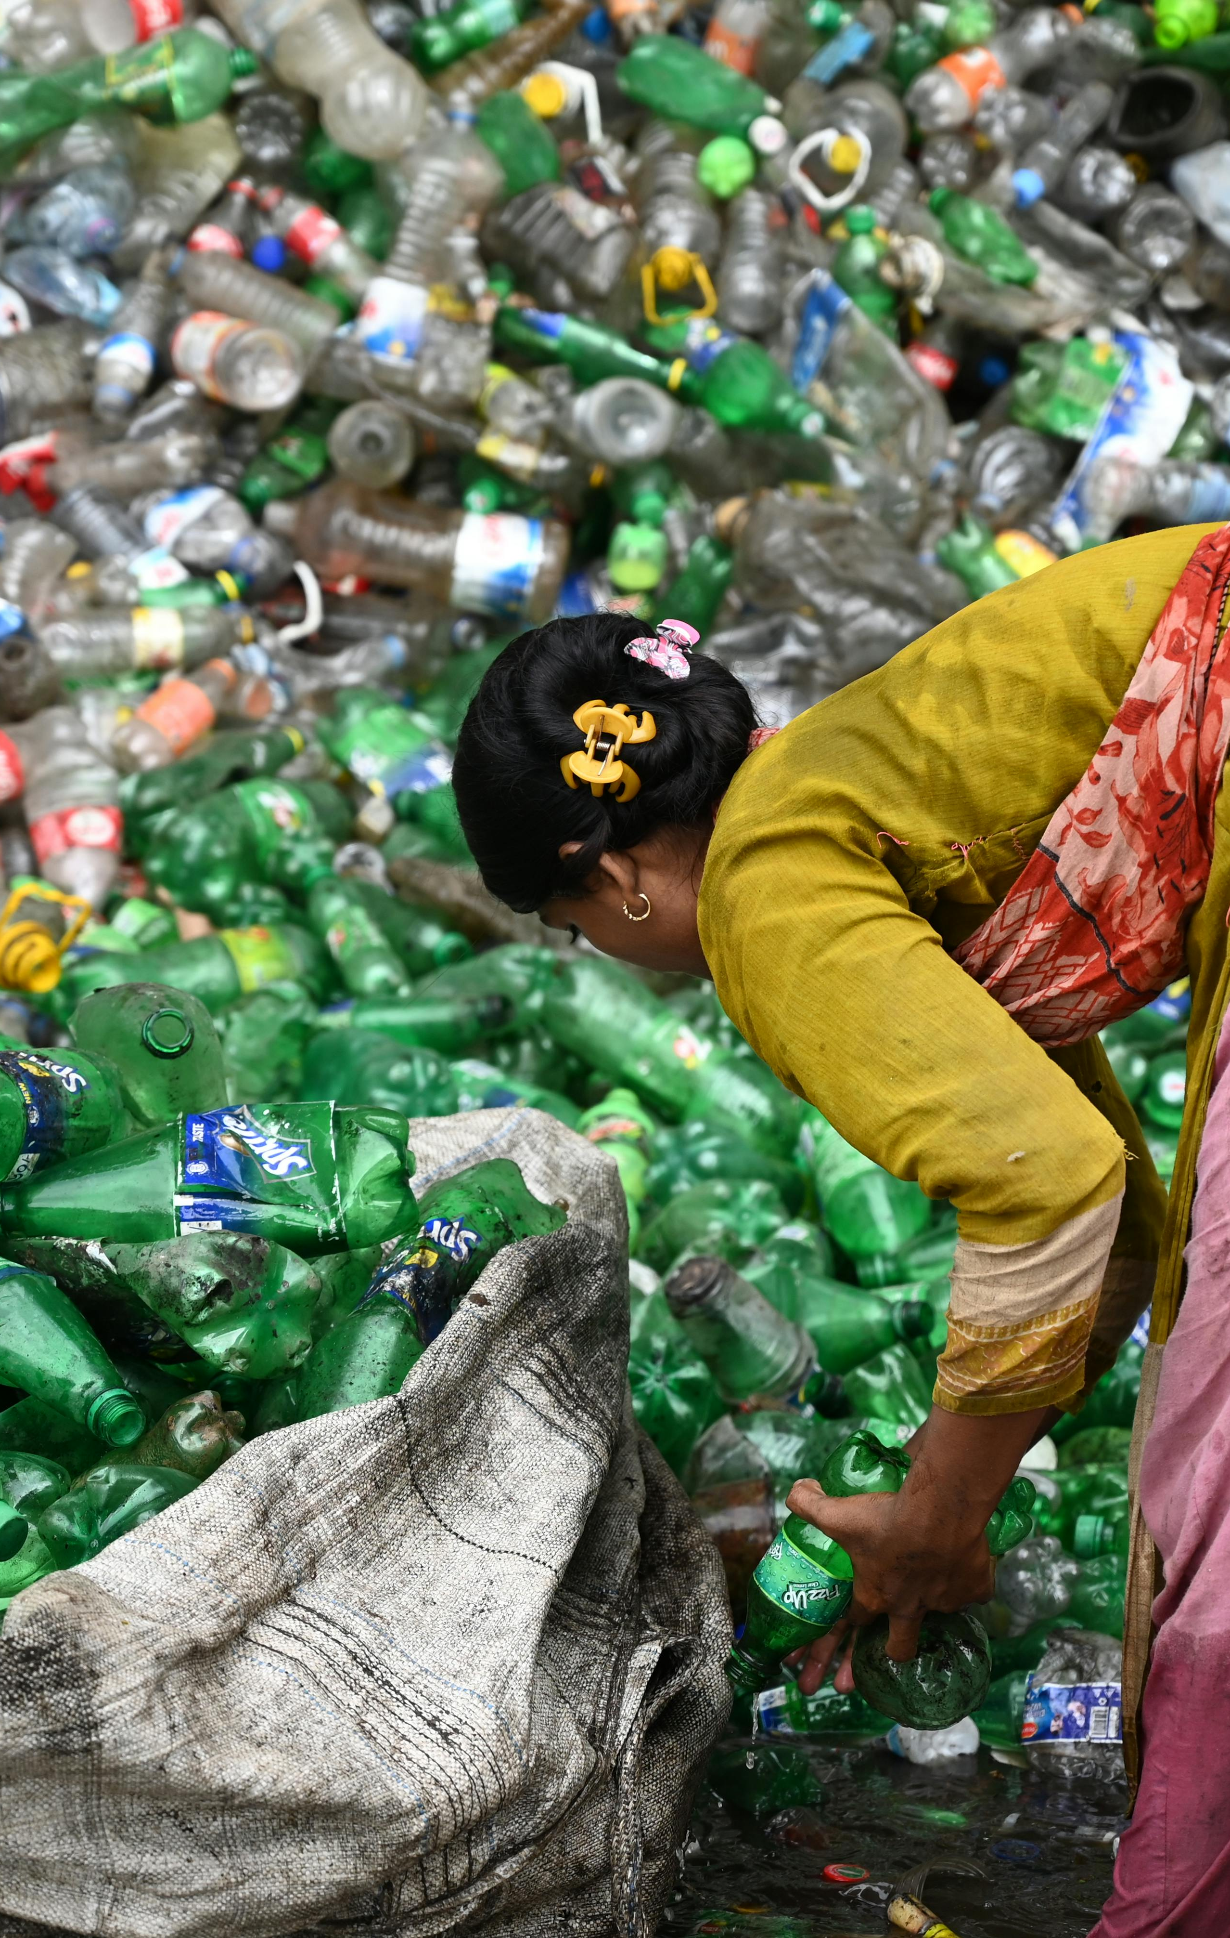
Problem Statement
Waste management is a major problem in cities and towns across the globe. Many regions around the world don’t have a proper waste collection and disposal system, and where there are such systems, they’re often not very efficient.

Slide 4
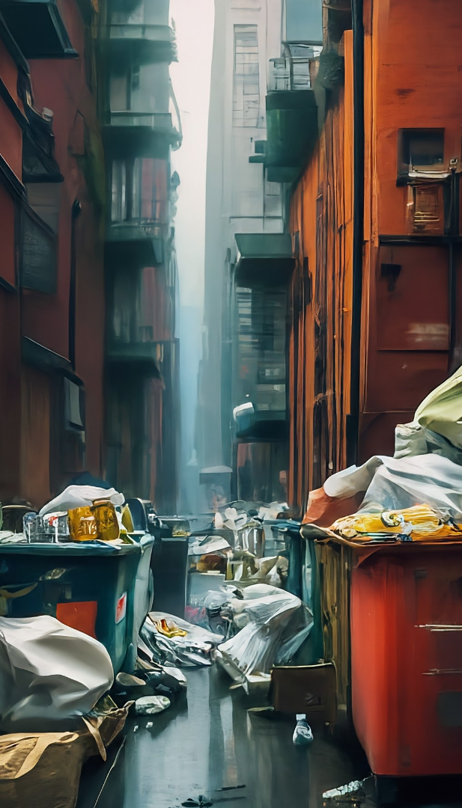
Challenges in Traditional Waste Management
Lack of efficient collection and transportation systems, leading to waste piling up in urban areas.
Insufficient segregation of waste at the source, making it difficult to recycle and repurpose materials.
Outdated landfill management practices, leading to environmental pollution and health concerns for nearby communities.

Slide 5
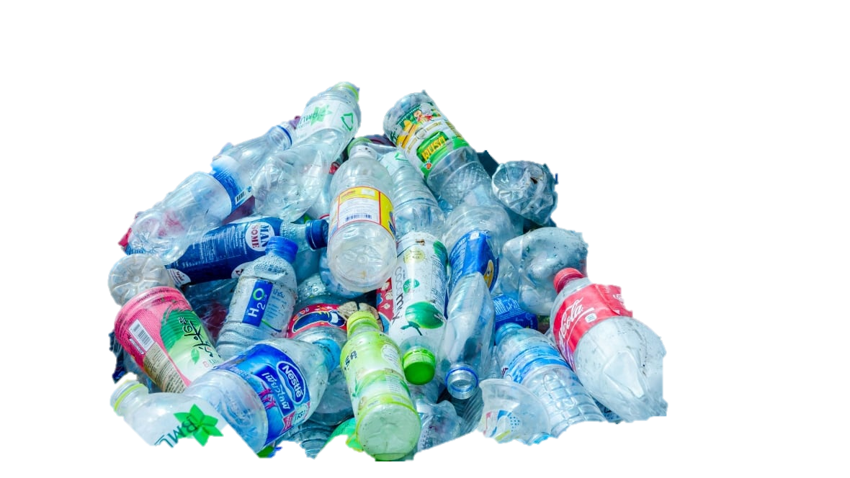
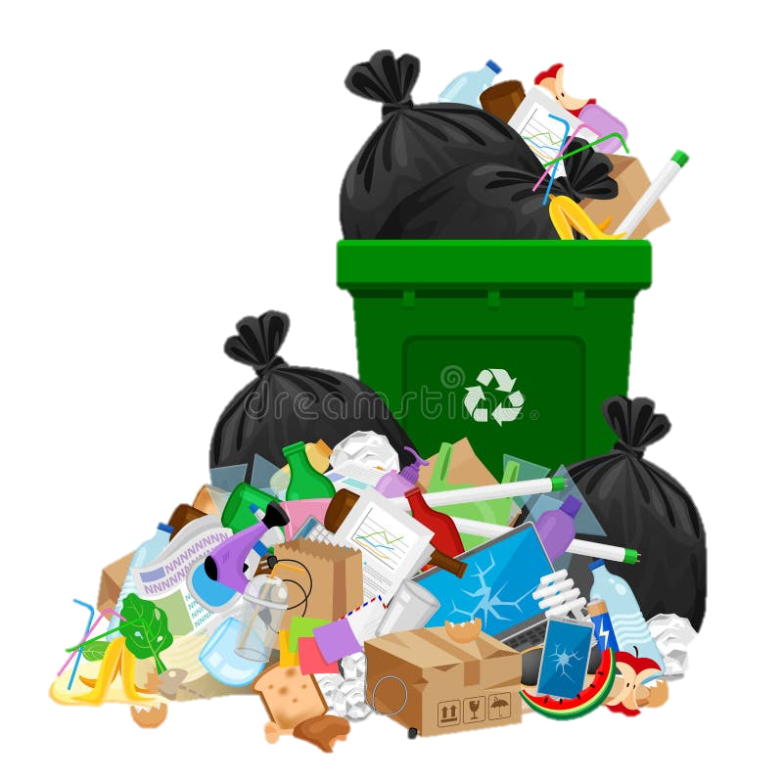
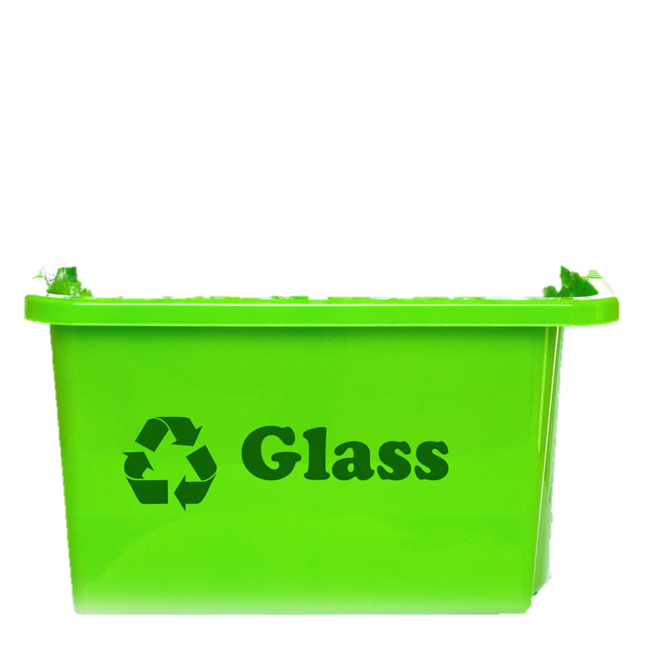
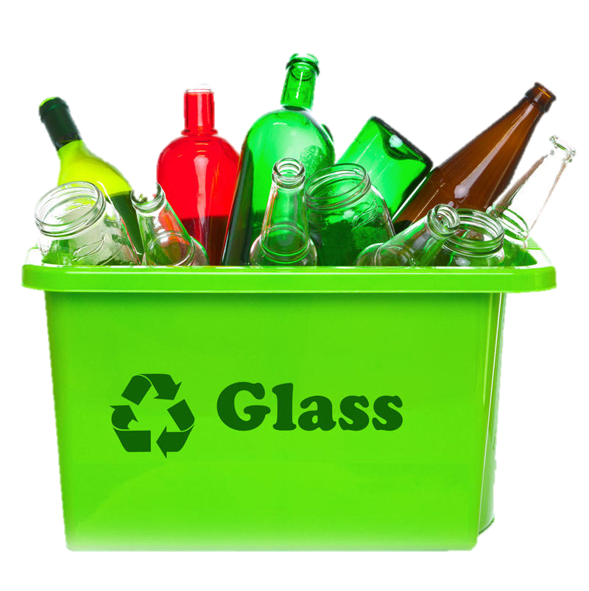

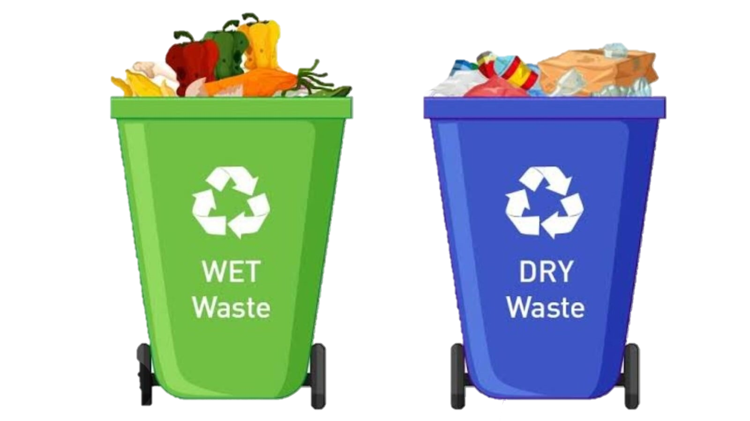
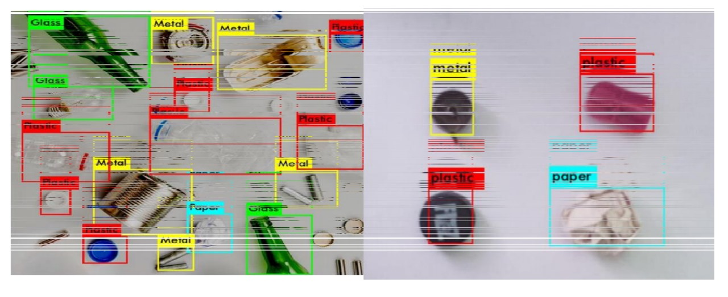
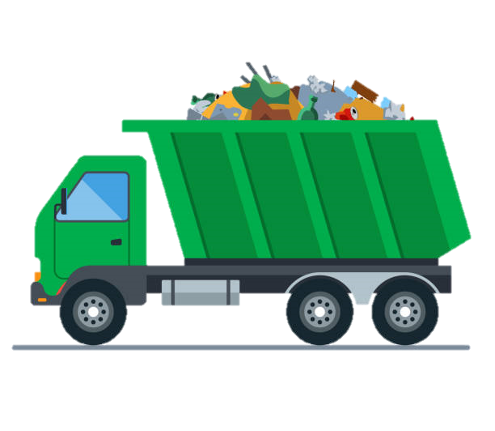
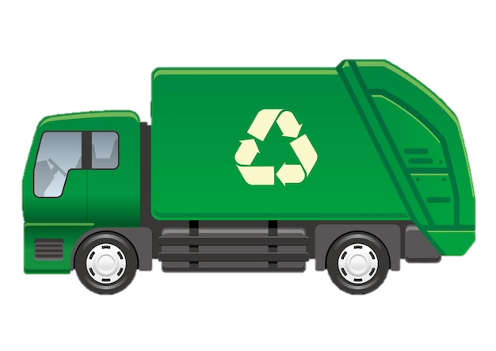
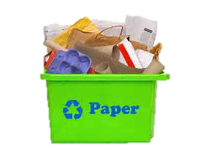

Our Approach
Plastic
YOLO v5 MODEL

Slide 6



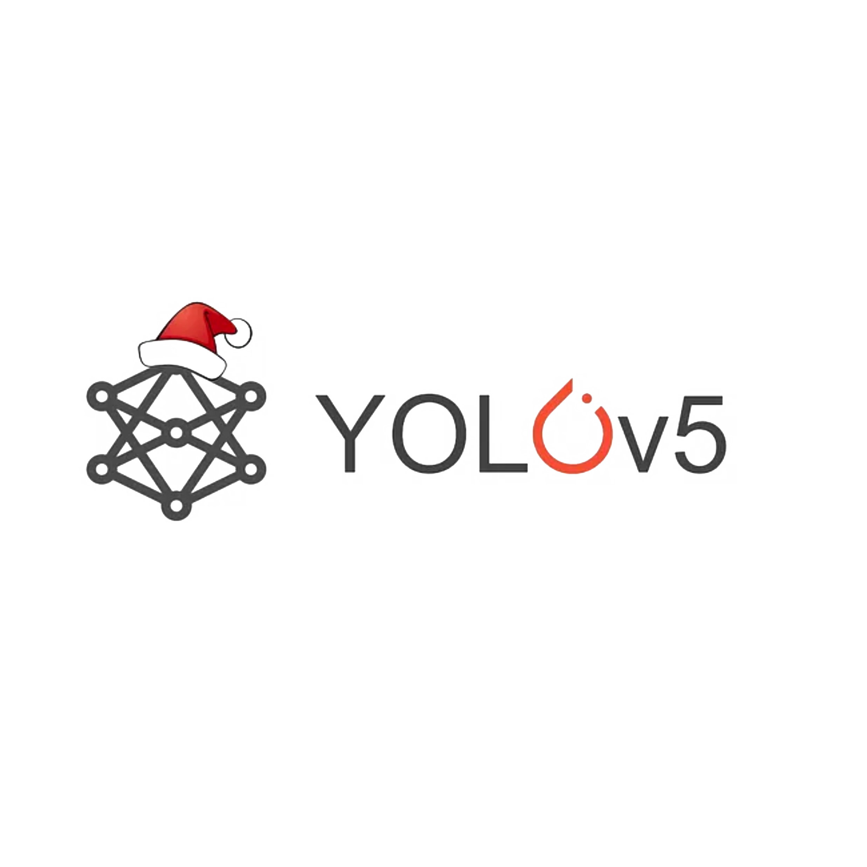
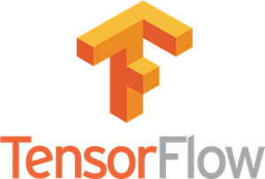

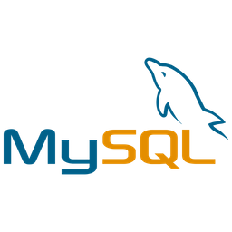
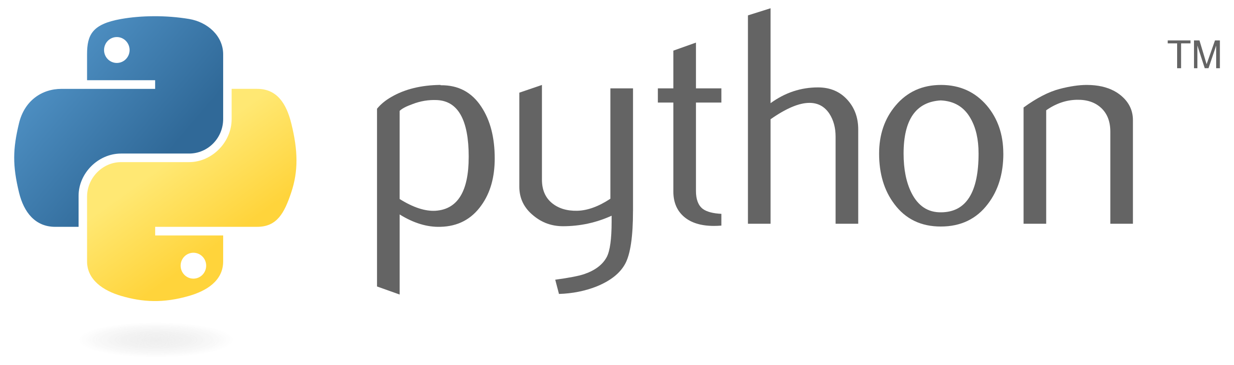

Technology Used
Part one: ML Module
Part Two: Web Application
For Central Dumping Ground
Frontend
HTML
CSS
BOOTSTRAP
Backend & Database

Slide 7

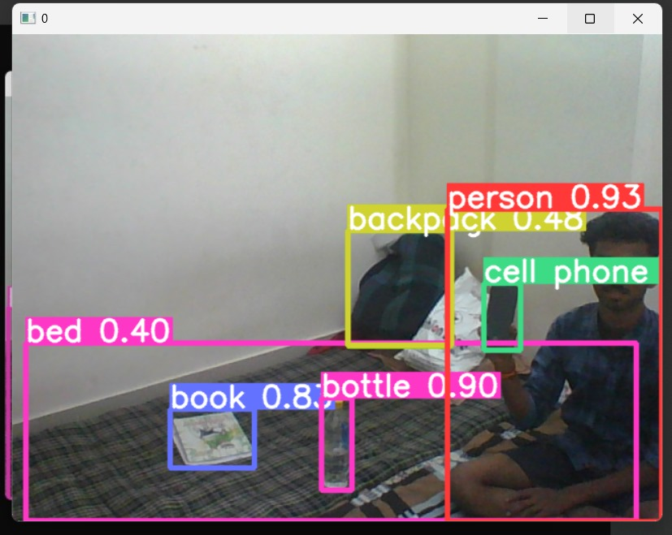
Solution
All Garbage is stored in dumping ground.
That garbage will go through machine, enabled with our algorithm module, which will detect and sort different materials.
Module name: Full form of YOLO is You Only Look Once. It is basically use to classify object.
Module Work: We can train a neural network to classify different types of object. Here we have to give 16,000 images as a class to the algorithm to classify object according to their need Its used to object detection.
Before Detection
After Detection

Slide 8

Collaboration with Local Garbage Collectors:
Local Communication: Coordinate with local collectors before sending waste to main dumps.
Monetary Incentives: Create revenue streams by receiving payment for waste from local collectors.
Cost Reduction: Decrease fuel and logistics expenses.
Partnerships with Startups:
Startup Collaboration: Partner with startups that use waste as raw materials.
Efficiency: Startups process waste quickly, reducing management costs.
Sustainable Products: Examples include incense sticks made from flower waste.
Increased Production: Faster collection boosts efficiency.

Slide 9
Overview of YOLO V5 Computer Vision
YOLO V5 is a state-of-the-art real-time object detection system powered by deep learning. It uses a convolutional neural network to rapidly identify and locate multiple objects within an image, making it ideal for applications like smart waste management.
The algorithm excels at detecting and classifying diverse waste items with high accuracy and speed, providing crucial data for optimizing collection and recycling efforts.

Slide 10
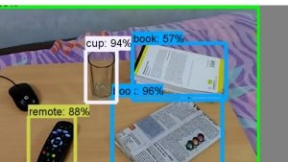
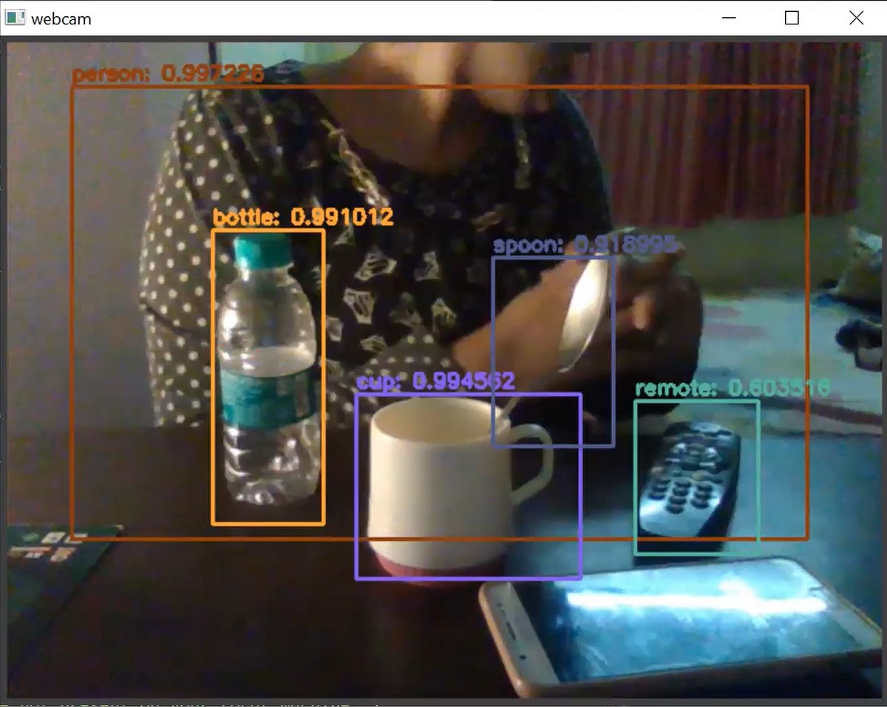
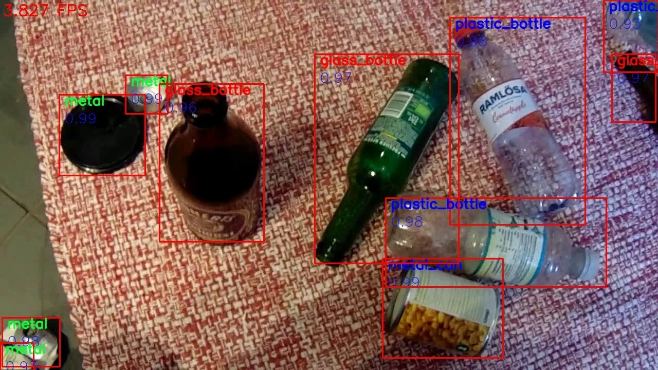
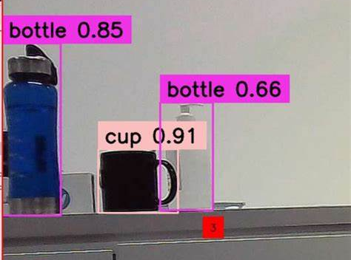
Detection By ML Model

Slide 11


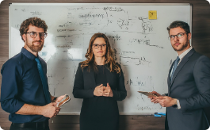
Engaging the Community for Participation
Waste Sorting Workshops
Community Cleanup Events
Stakeholder Collaboration
Host interactive workshops to educate residents on proper waste sorting and recycling practices, encouraging active community participation in the smart waste management system.
Organize regular neighborhood cleanup events to collect and properly dispose of waste, fostering a sense of pride and ownership in the local environment.
Facilitate regular meetings between community leaders, waste management experts, and local authorities to gather feedback and incorporate community needs into the smart waste system.

Slide 12

Now Lets See Demo
Click Here Watch Demo

Slide 13
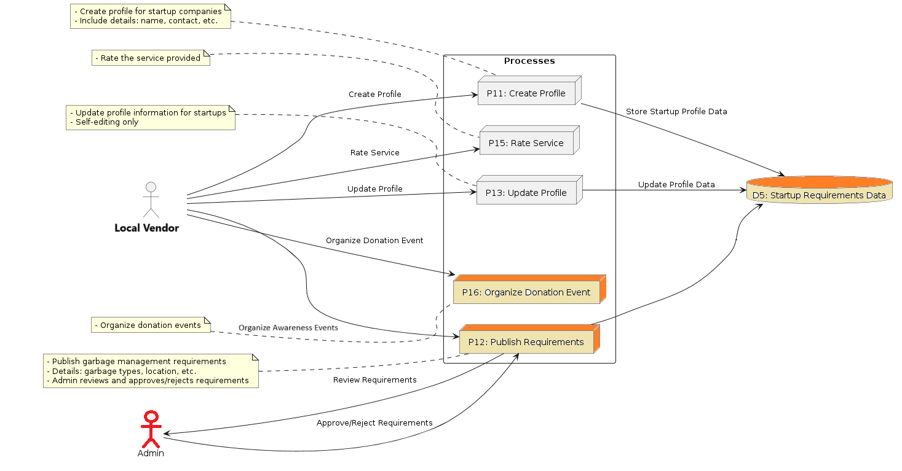
DFD Local Vendor

Slide 14
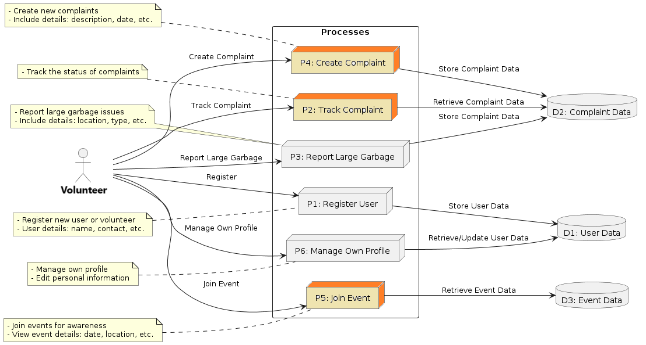
DFD Volunteer Vendor

Slide 15
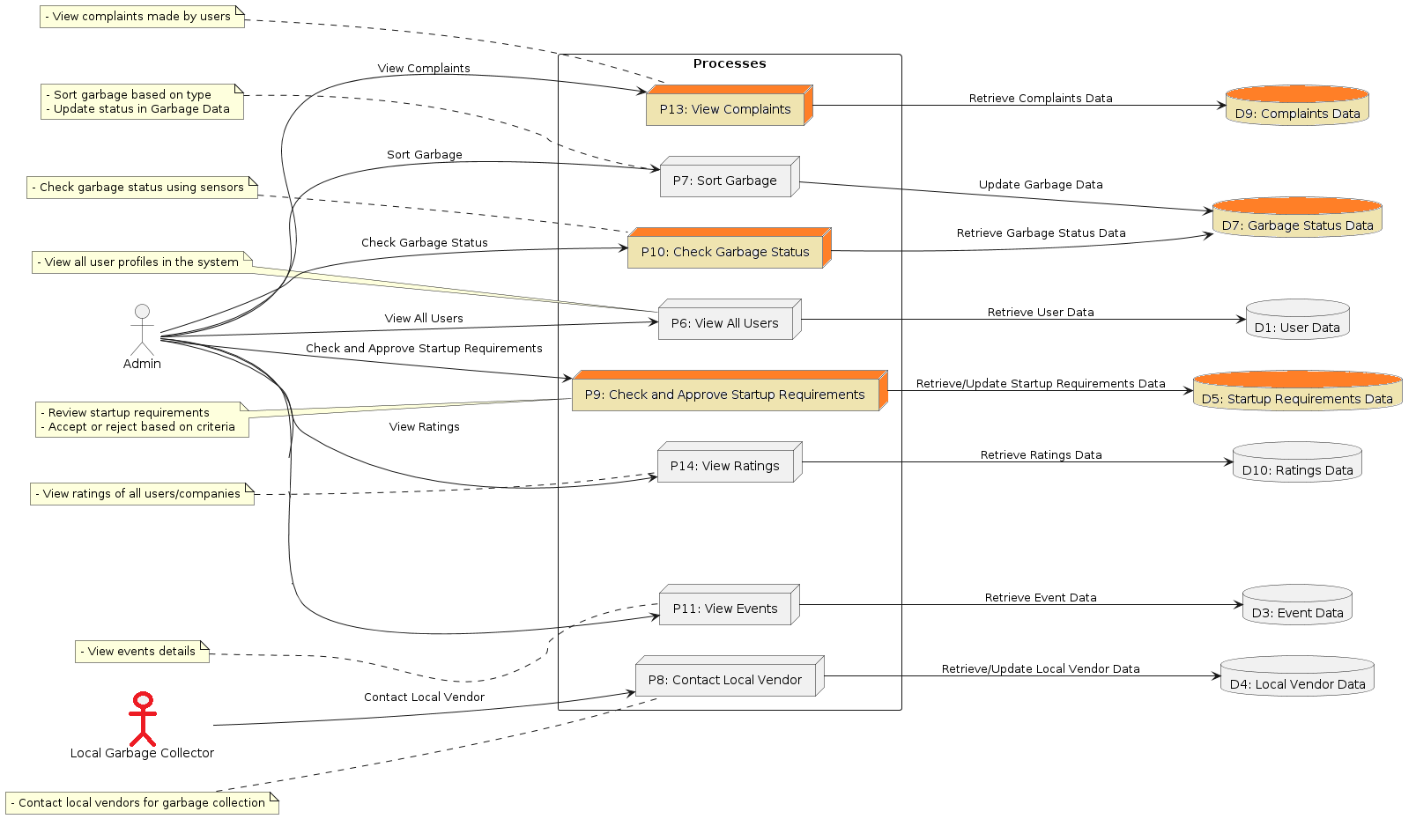
DFD Admin Vendor

Slide 16
Conclusion
The smart waste management system leveraging YOLO V5 computer vision and machine learning has the potential to revolutionize waste management practices.
By automating waste detection, classification, and route optimization, this innovative approach can significantly improve efficiency, reduce costs, and drive sustainable waste reduction initiatives.

Slide 17
SmartBin
Thank You !
Any Questions ?

